Slide 1
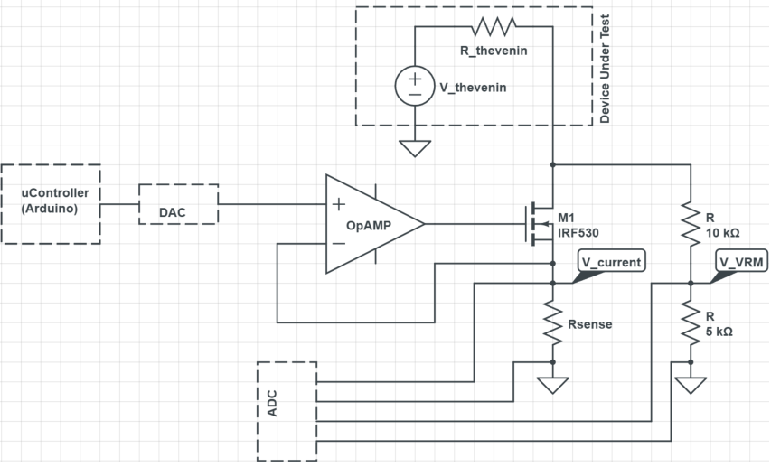
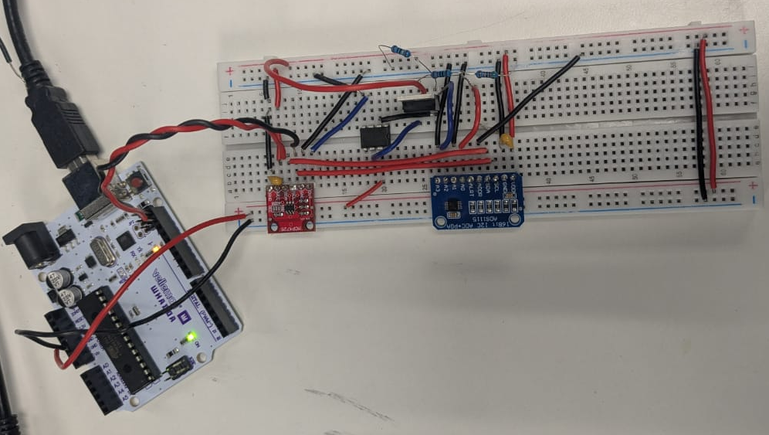
Lab 16 Findings
Joseph Abroquah
Data Collected: 11/03/2025
Schematic
Goal: build a solderless breadboard of an instrument droid that characterize any voltage source using Thevenin voltage and Thevenin resistance as a function of output current
POR:
  Install Adafruit_MCP4725 to code the DAC
  Power the ADC, DAC and opAmp with 5V from the Arduino
  Take measurements of known VRM
    Function generator
  Take measurement of unknown VRM
    5V from Arduino
    3.3 from Arduino
SSB version

Slide 2
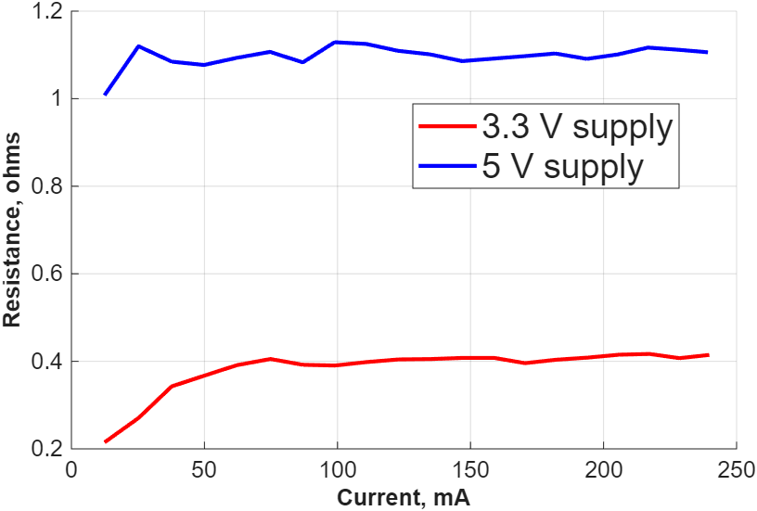
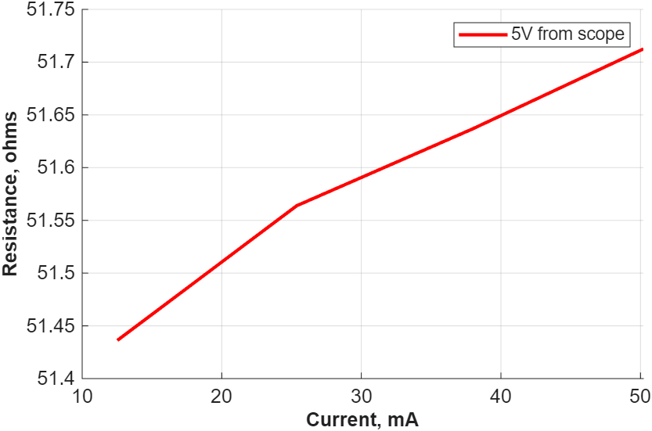
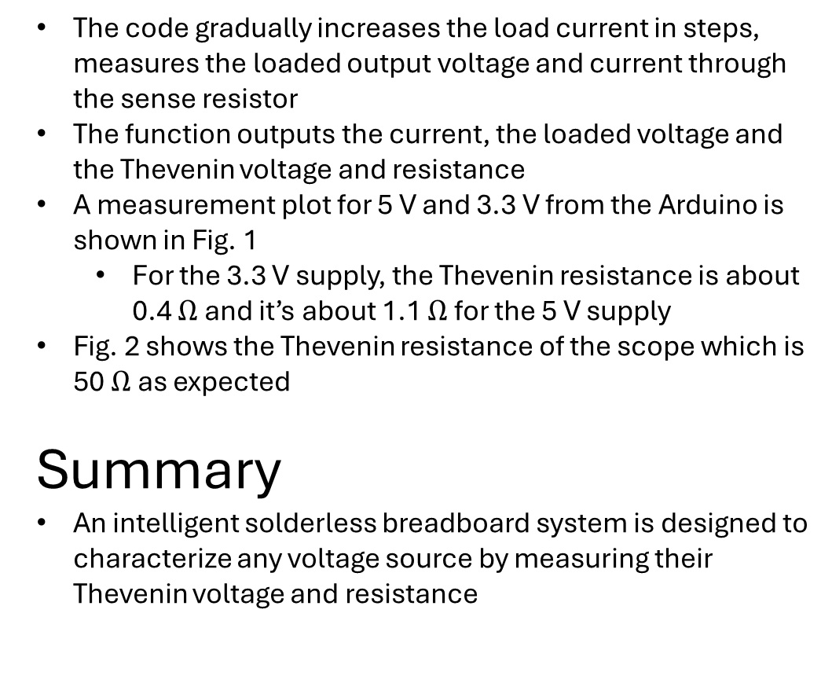
Results
Fig. 1.
Arduino Power Supply
The code gradually increases the load current in steps, measures the loaded output voltage and current through the sense resistor
The function outputs the current, the loaded voltage and the Thevenin voltage and resistance
A measurement plot for 5 V and 3.3 V from the Arduino is shown in Fig. 1
  For the 3.3 V supply, the Thevenin resistance is about 0.4 $Ω$ and it’s about 1.1 $Ω$ for the 5 V supply
Fig. 2 shows the Thevenin resistance of the scope which is 50$Ω$ as expected
Summary
An intelligent solderless breadboard system is designed to characterize any voltage source by measuring their Thevenin voltage and resistance
Fig. 2.
Scope Function Generator

